Slide 1
OUR VISION

Slide 2

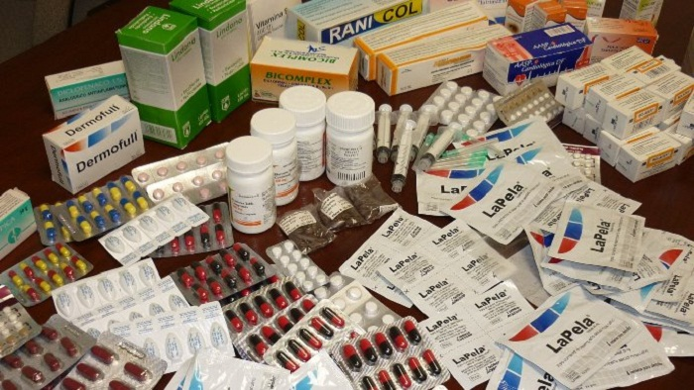
Fake medicine captures around 50% of the market

Slide 3
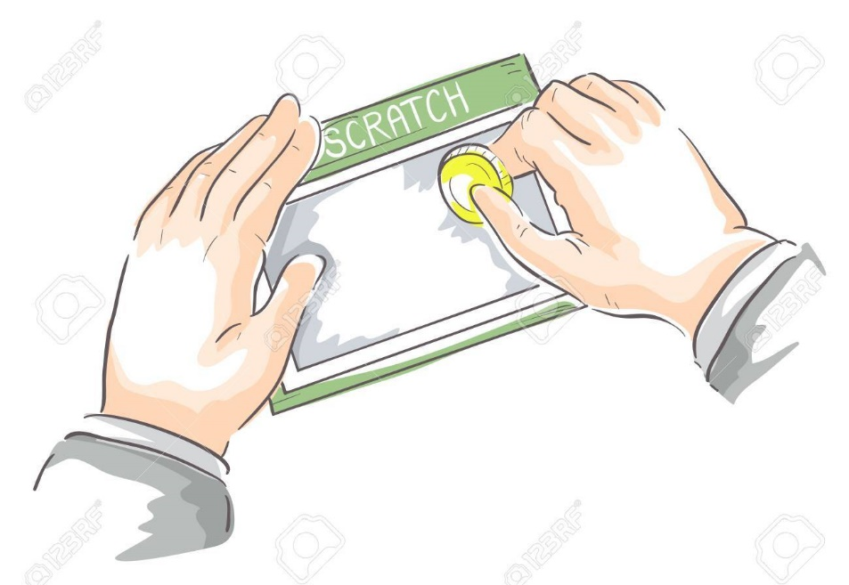
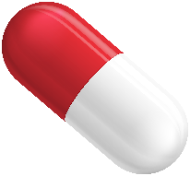
Solution: Validation of medicine by scratching a code on the medicine box and checking it on mobile

Slide 4
Existing Business Model
Manufacturer
Distributor
Retailer
Consumer
Our Business Model
Manufacturer + We as a Distributor
Retailer
Consumer

Slide 5
How the business is sustainable
One way to generate the revenue.
Manufacturing Cost + scratch code cost+1% profit
Example:
100+2+1=103 rupees

Slide 6
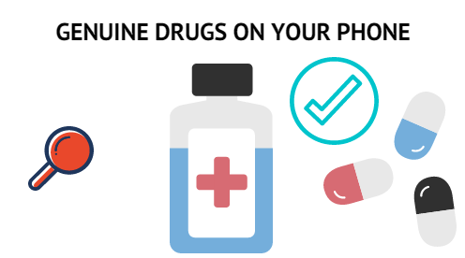
WHY PEOPLE WILL TRUST US?
Manufacturer 2x sales boost and reputation
Retailer becomes authenticated’
For Consumer

Slide 7
Competion already?
No system for validation in Pakistan except a Manual System
M-pedigree

Slide 8
